Slide 1

Exploratory Data Analysis
<Hate Speech detection using NLP>
<16/08/2023>

Slide 2
Team Members
Member No. | Name | Email | Country | College | Specialization
01 | Zyad Hussein | zyadrashad262@yahoo.com | Egyptian | University of York | NLP

Slide 3

Agenda
Executive Summary
Problem Statement
Approach
EDA
EDA Summary
Recommendations

Slide 4
Executive summary
Problem Addressed:
Hate speech on social media platforms poses safety and inclusivity challenges.
Proposal:
Utilize transformer-based NLP model for hate speech detection in Twitter tweets.
Benefits:
User Safety: Creates a safer and respectful online community.
Time and Cost Savings: Reduces manual content review.
Scalability: Accommodates growing user activity and content.
Adaptability: Fine-tuning for changing language trends and hate speech expressions.

Slide 5
Problem proposed
Hate speech on rise on social media
Targeting groups with different ethnicities, background, race and colour.
Manual identification is time-consuming and inconsistent.
Hate speech poses safety and inclusivity challenges on individuals and groups.
Implementation of NLP to achieve hate speech elimination:
Enhances user safety, promotes respectful discourse, and combats hate speech effectively.
Increase user interaction at a safe platform
Increase revenue based upon the increase of user interactions

Slide 6

Approach
Utilization of NLP deep learning models such as BERT
Transformer Architecture Captures language nuances and dependencies.
Automates identification process which can leverage media platforms revenues through cost saving (Real-time detection).
Multilingual Support: Detects hate speech across languages.
Contextual Understanding: Differentiates between hate speech and opinions.

Slide 7
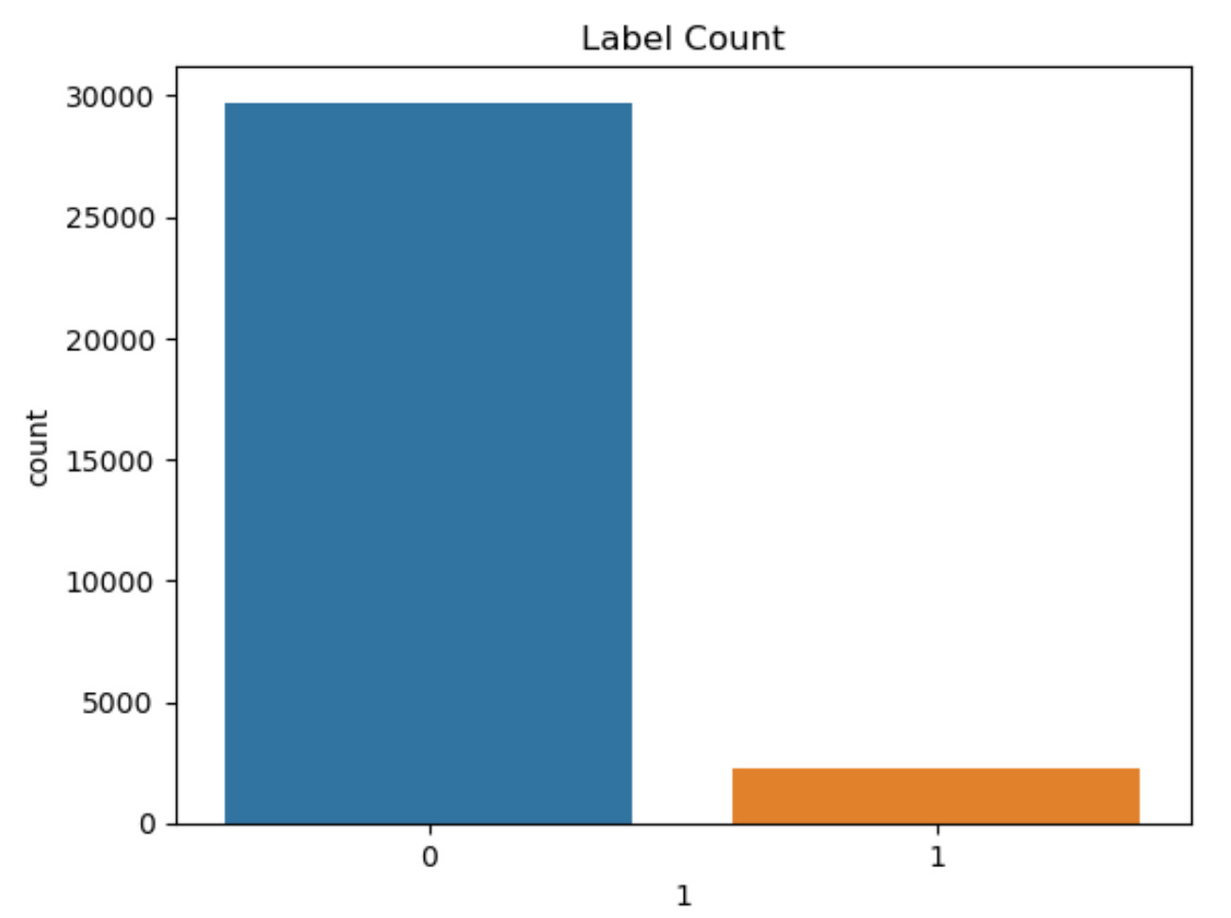
EDA Analysis
A dataset was gathered to train NLP model on detection
Dataset revealed that approximately 2500 tweets were recognised as hate speech across 39700 tweets.
Even though number could appear small, it still means that about 2500 negative speech were created and could be targeting users

Slide 8
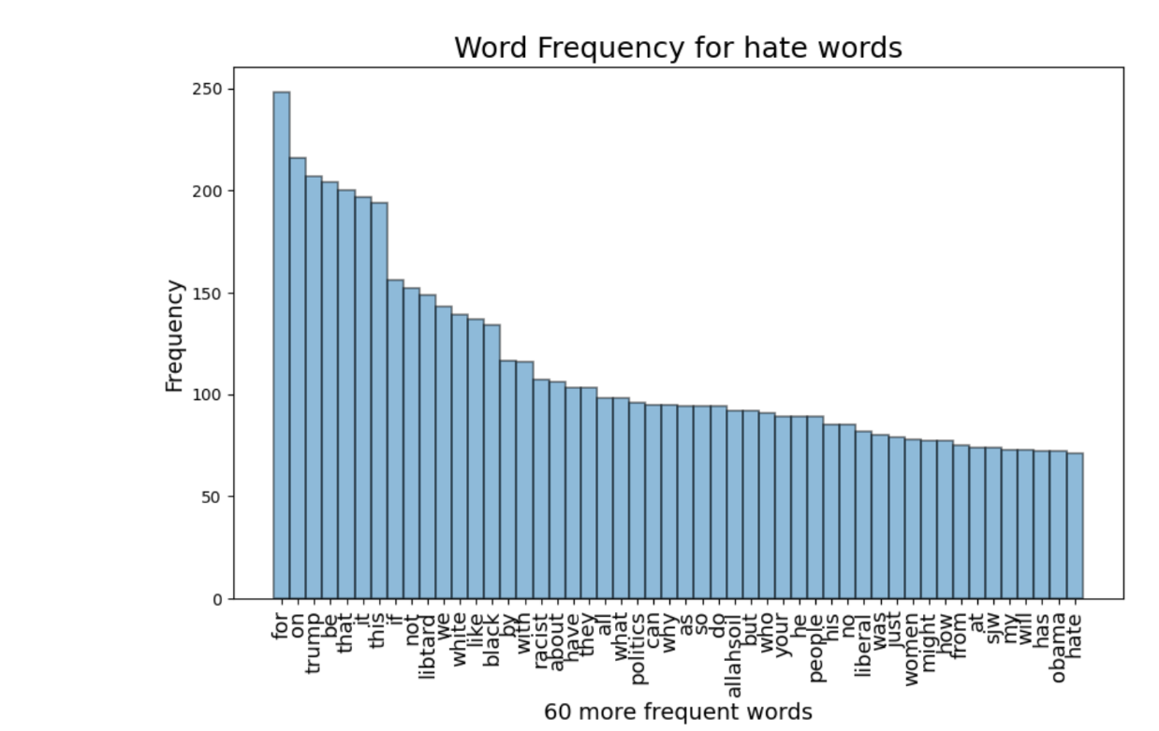
EDA Analysis continued
According to analysis of 2500 hate speech, it was found that:
The most repeated words were ‘Trump’, ‘white’, ‘black’, ‘racist’, ‘allahsoil’, and ‘women’.
Occurrence Frequency of ‘Trump’ reached more than 200 within 2500 tweets.
‘White’ and ‘black’ occurrence frequency were about 140 each in 2500 tweets.
Occurrence frequency of ‘racist’ in negative speech is about 100 per 2500.
These results are high indication of racism, individual targeting and sexism as well as targeting sacred religious names.

Slide 9
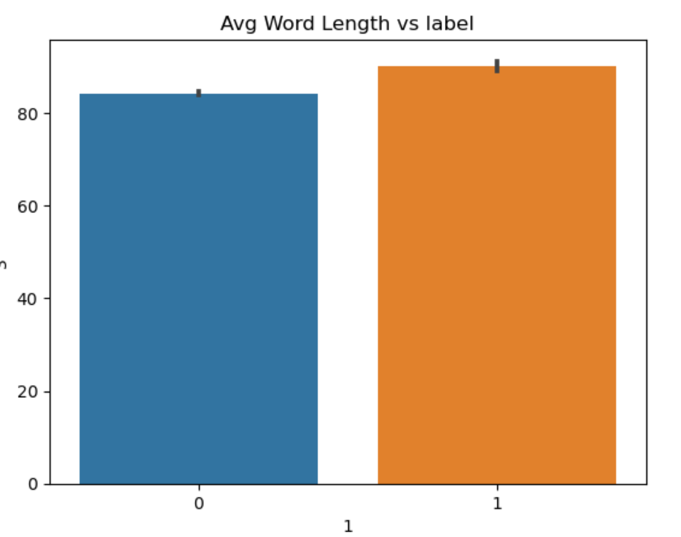
EDA Analysis
A quantitative analysis of text data was performed to find out the average word count per negative speech; reached 85-89 words.
Whereas positive speech word count reached 82-84 counts.
The results yielded that negative speech is likely to appear in long tweets as in forms or sentences or possibly paragraphs.

Slide 10
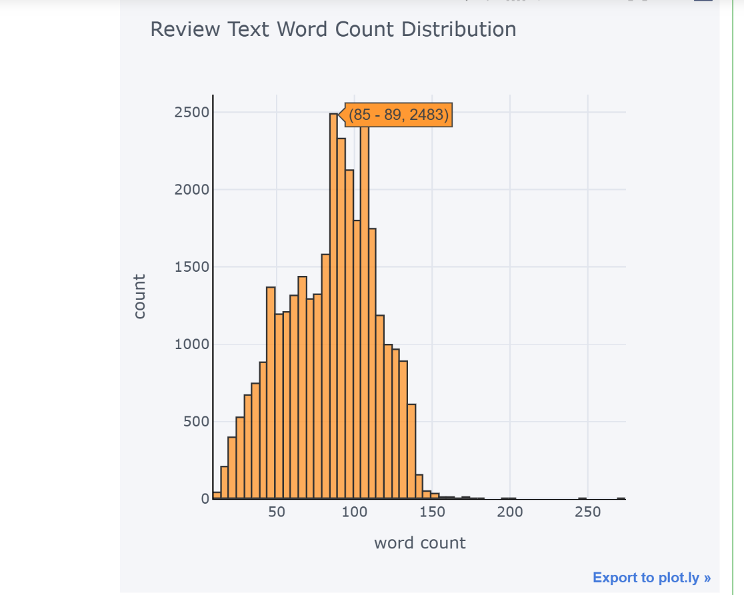
EDA Analysis
Negative speech has also recorded the highest tweet word count among the dataset as it was found that frequency of the highest word count is 85-89 words which relate to negative speech category.
It has recorded 2483 negative tweets with 85–89 word count.

Slide 11
EDA Summary
A descriptive statistics was designed to identify the amount of hate speech compared to positive speech.
a Univariate Analysis was designed to identify the frequency of hate speech words.
A quantitative analysis of text data was created to find out the average word count per negative speech.
A Categorical / univariate analysis was also designed to identify the highest word count and its frequency which allowed for category identification of where highest word count tweets lie in.

Slide 12
Final Recommendation
According to the conducted analysis, it is believed that a automated moderation of the posted content as it is evident that hate speech is presented in the acquired dataset.
A feedback loop should be created to allow users to report unrecognised hate speech to enhance detection accuracy.
Given that higher word counts has been related to negative speech, it is possible to concentrate on high word count tweets and analyze them.
An NLP model such as BERT, which utilizes transformers is needed to automate the identification process and aid in the elimination of hate speech.

Slide 13
Hate Speech Identification using NLP
Thank You

